Slide 1


知识蒸馏
汇报人：刘源鑫
2020.9.22

Slide 2

1
KD Background
2
Knowledge: What to distill?
3
KD Scheme: How to distill?
4
Discussions
目录
Contents

Slide 3

01
KD Background

Slide 4
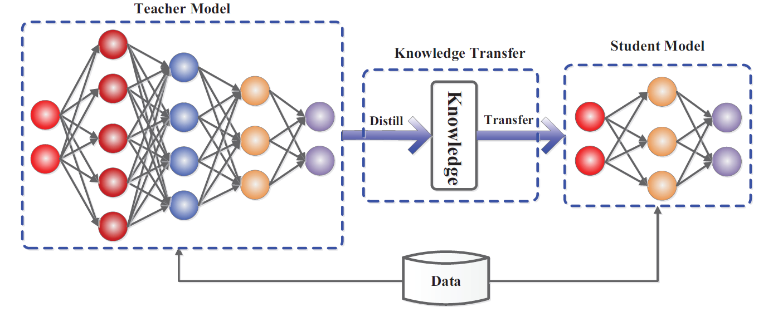
KD Background

Slide 5
02
Knowledge: What to distill?

Slide 6
Knowledge: What to distill?
Response-based Knowledge
Feature-based Knowledge
Relation-based Knowledge

Slide 7
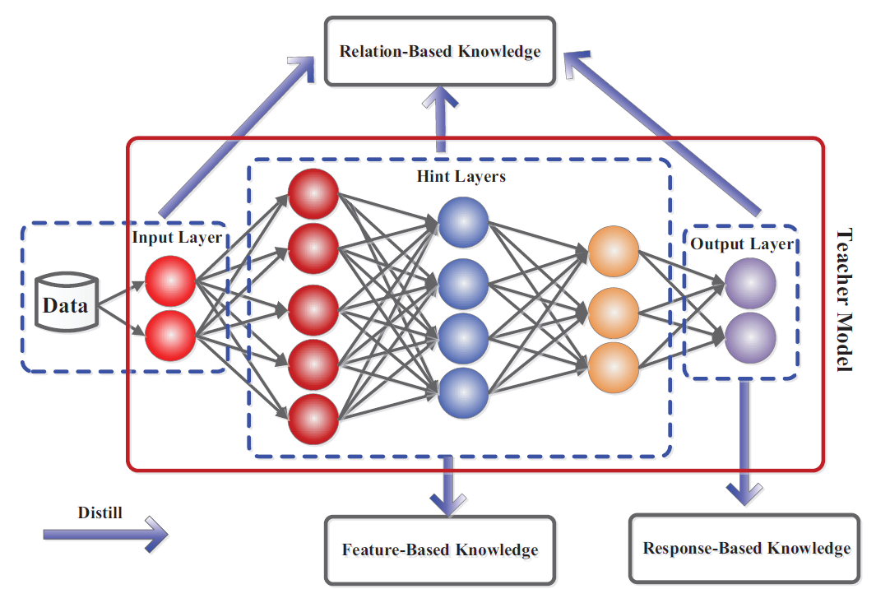
Knowledge: What to distill?

Slide 8
Knowledge: What to distill?
Response-based Knowledge
Feature-based Knowledge
Relation-based Knowledge

Slide 9
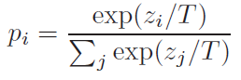
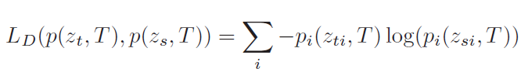
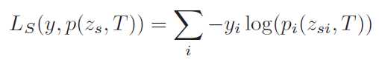
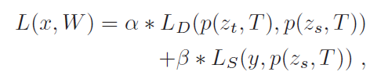
Response-based Knowledge
模型预测概率分布：
计算teacher预测分布和student预测分布的交叉熵：
student预测概率分布与ground-truth one-hot的交叉熵：
结合两个交叉熵Loss:

Slide 10
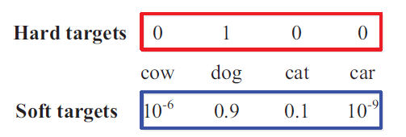
Response-based Knowledge
Soft-label好在哪里?
Notes:
比hard label好的原因：
1、包含类别间相似度信息
2、Label smoothing?

Slide 11
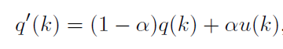
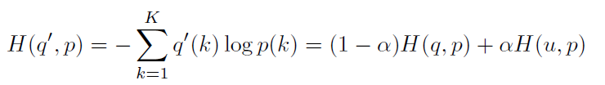
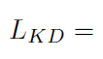
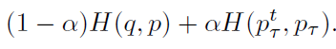
Response-based Knowledge
Soft-label vs Label Smoothing
Notes:
比hard label好的原因：
1、包含类别间相似度信息
2、Label smoothing?

Slide 12
Knowledge: What to distill?
Response-based Knowledge
Feature-based Knowledge
Relation-based Knowledge

Slide 13
Feature-based Knowledge
Neuron activations
Feature-based Knowledge
Attention maps
Distribution of Neuron activations (over the dataset)

Slide 14
Feature-based Knowledge
Neuron activations
Feature-based Knowledge
Attention maps
Distribution of Neuron activations (over the dataset)

Slide 15
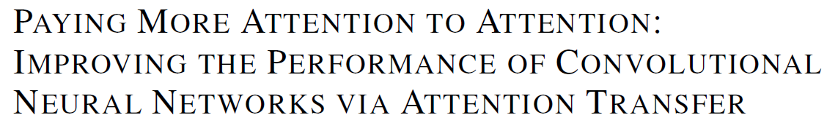
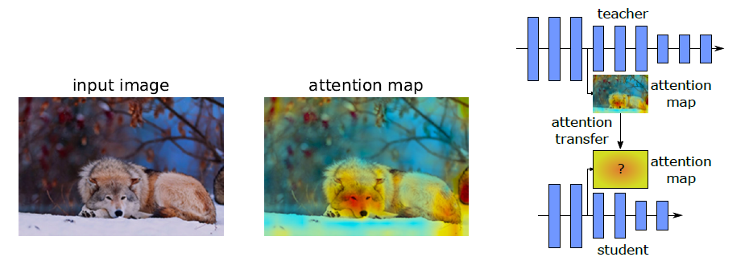
Feature-based Knowledge

Slide 16
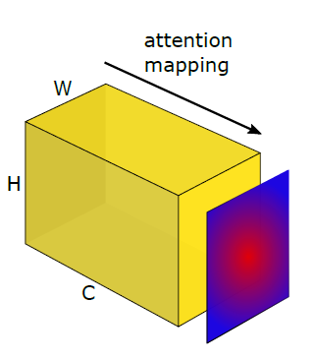
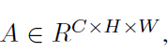
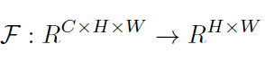
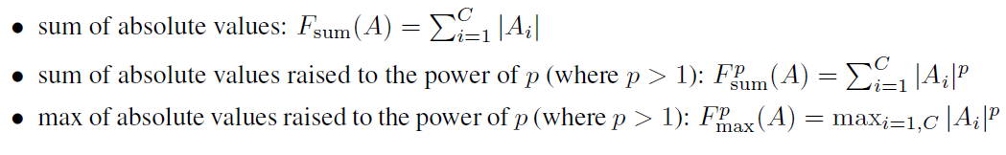
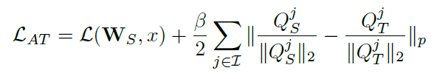
Feature-based Knowledge
假设特征图为：
将其压缩为二维矩阵，得到spatial attention:
三种spatial attention的计算方法：
最终loss为：

Slide 17
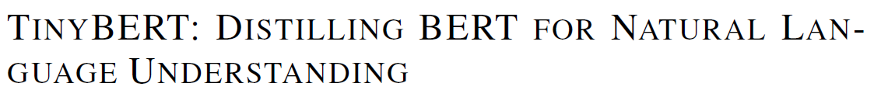
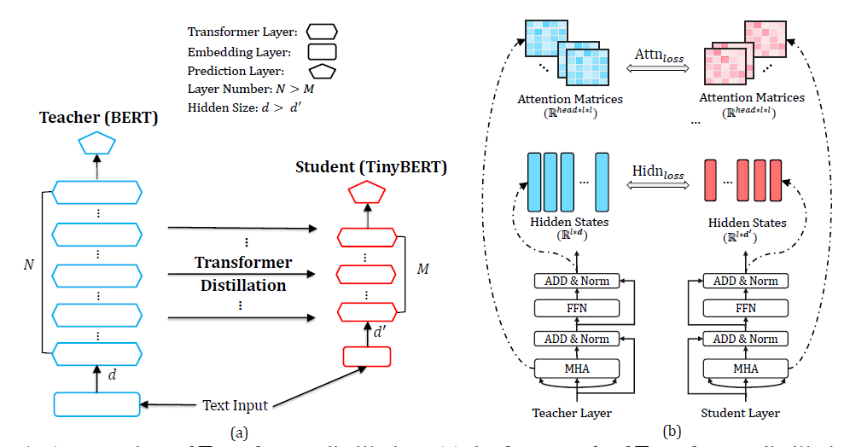
Feature-based Knowledge

Slide 18
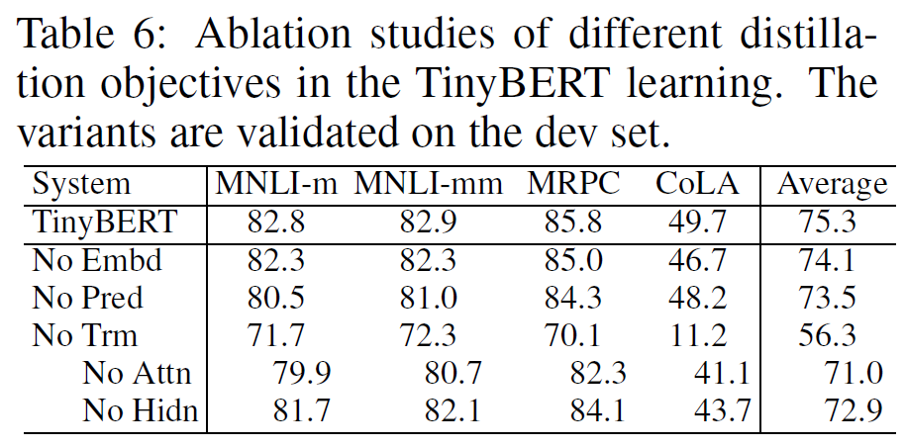
Feature-based Knowledge

Slide 19
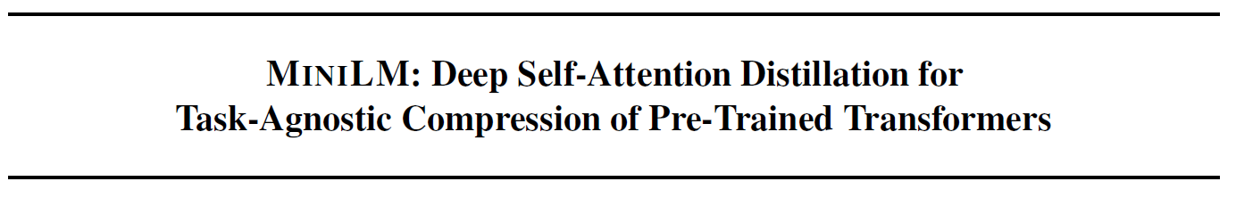
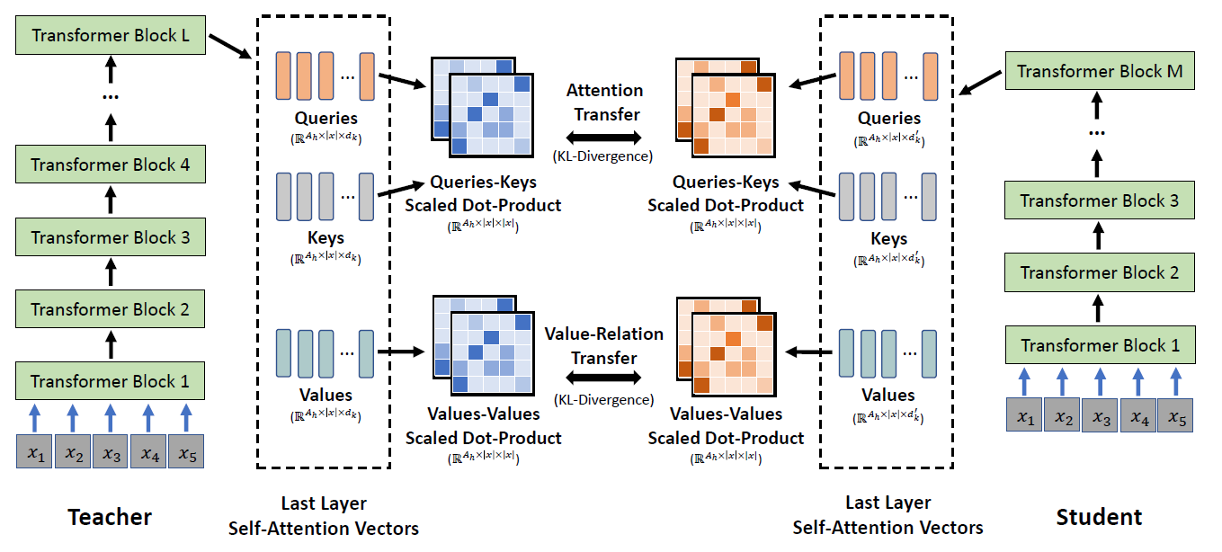
Feature-based Knowledge

Slide 20
Feature-based Knowledge
不需要 layer mapping
引入value-value relation，提升效果 （why?）
Advantages
Task-Agnostic
Notes:
No layer mapping: teacher 和 student 的层数更加灵活

Slide 21
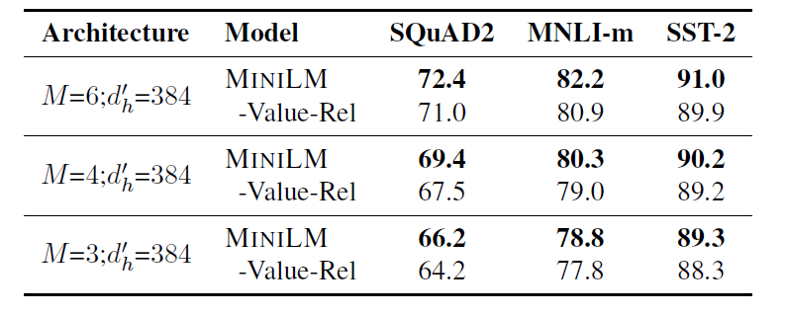
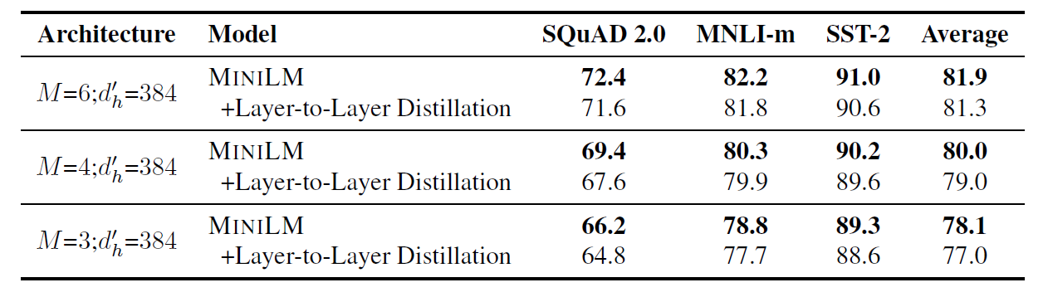
Feature-based Knowledge
Notes:
摘要生成，跨语言文本分类，问题生成

Slide 22
Feature-based Knowledge
Neuron activations
Feature-based Knowledge
Attention maps
Distribution of Neuron activations (over the dataset)

Slide 23
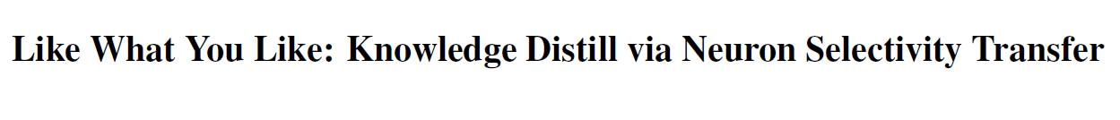
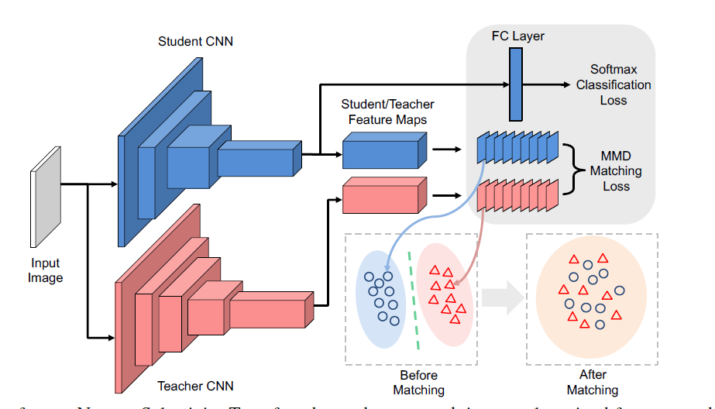
Feature-based Knowledge
Notes:
如何衡量样本分布的距离？

Slide 24
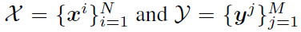
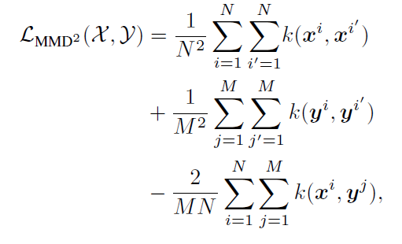
Feature-based Knowledge
Maximum Mean Discrepancy (MMD)是一种衡量样本概率分布的指标。
假设有两个样本集合 ，它们的MMD可以写为：
其中k为衡量两个样本相似度的核函数。

Slide 25
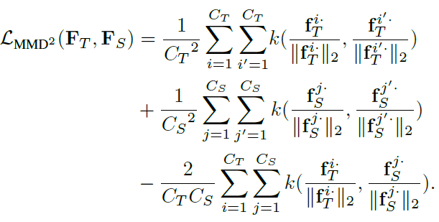
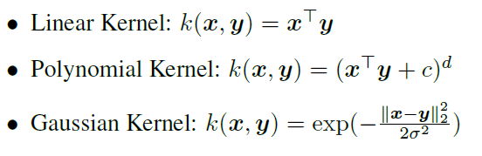
Feature-based Knowledge
用teacher和student分布提取样本特征，MMD可以写为：
可以选择的核函数有：

Slide 26
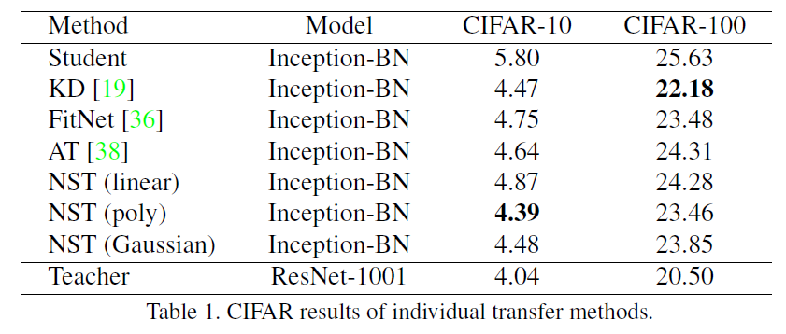
Feature-based Knowledge
Notes:
相对KD提升很小

Slide 27
Knowledge: What to distill?
Response-based Knowledge
Feature-based Knowledge
Relation-based Knowledge

Slide 28
Relation-based Knowledge
Instance relation
Relation-based Knowledge
Feature relation

Slide 29
Relation-based Knowledge
Instance relation
Relation-based Knowledge
Feature relation

Slide 30
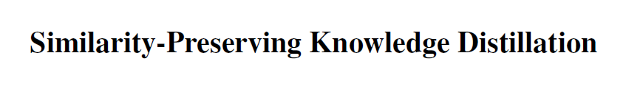
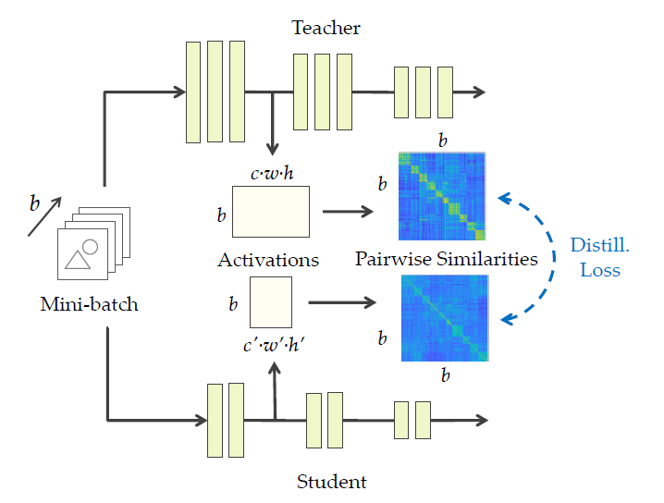
Relation-based Knowledge

Slide 31
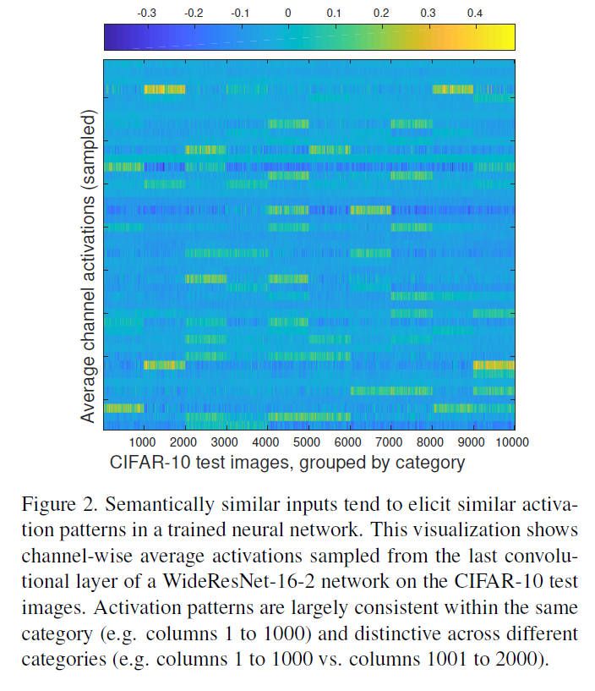
Relation-based Knowledge

Slide 32
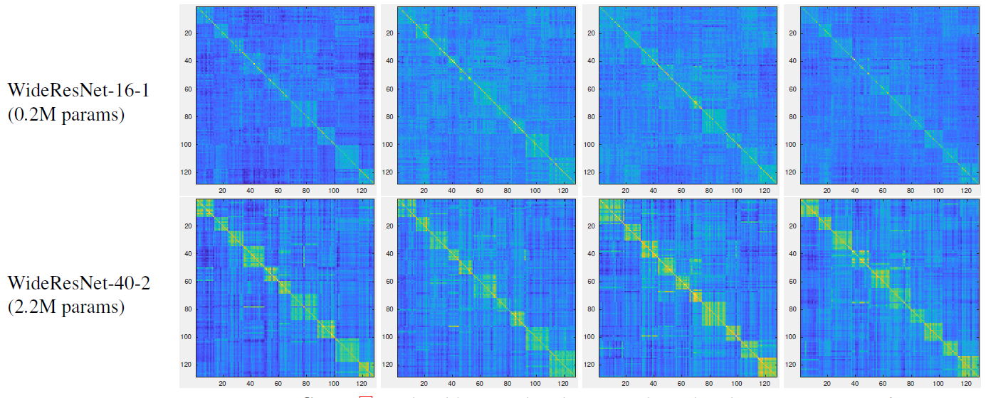
Relation-based Knowledge

Slide 33
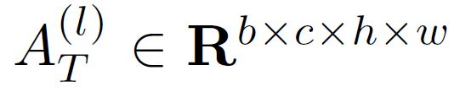
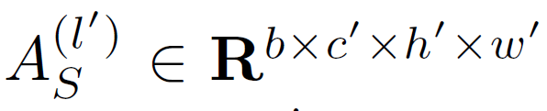
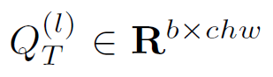
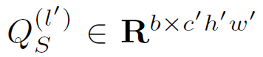
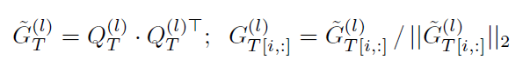
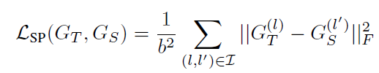
Relation-based Knowledge
一个batch的数据，Teacher和student在第 l 和 l’ 层的输出特征图分别为：
将c, h, w三个维度合并，得到 和
然后计算一个batch中数据的两两相似度矩阵：
Teacher的相似度矩阵作为student要学习的knowledge：
Notes:
Cos距离

Slide 34
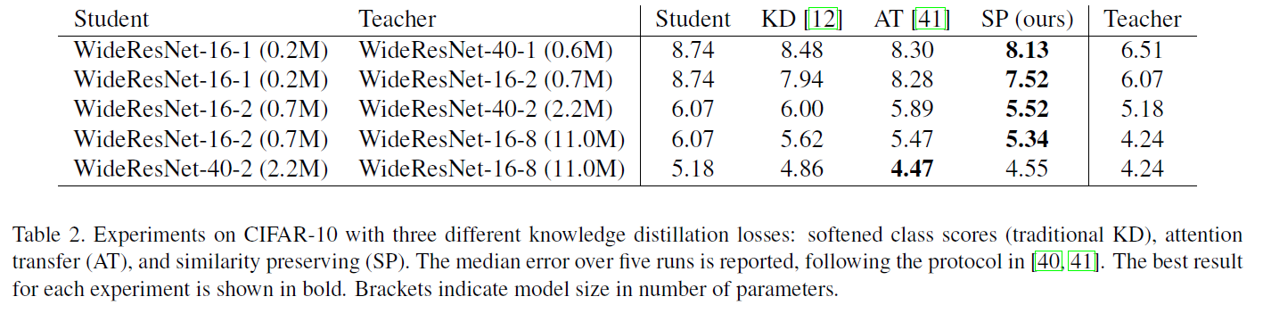
Relation-based Knowledge

Slide 35
Relation-based Knowledge
Instance relation
Relation-based Knowledge
Feature relation

Slide 36
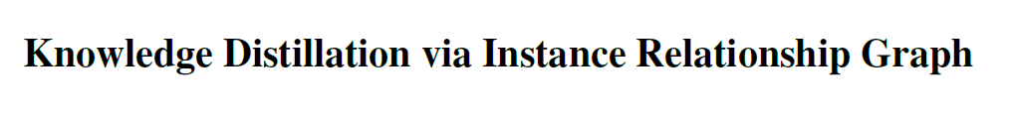
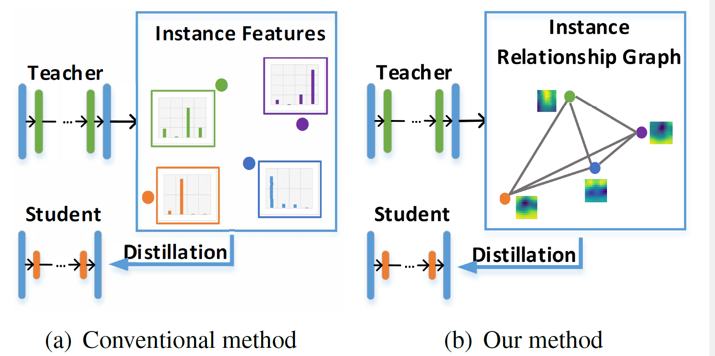
Relation-based Knowledge

Slide 37
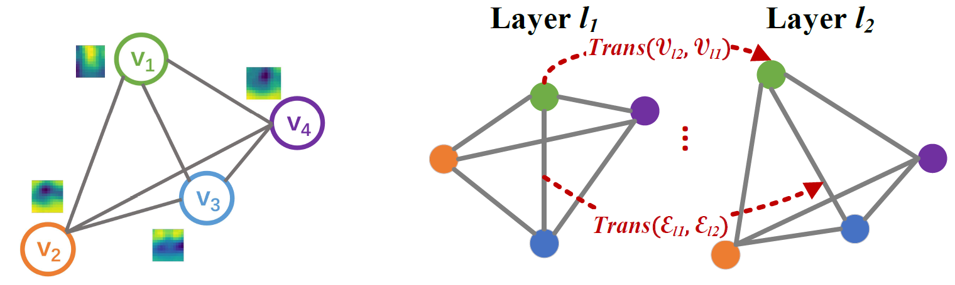
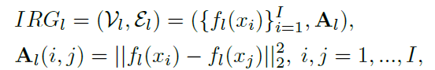
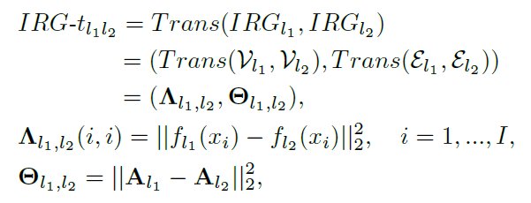
Relation-based Knowledge
Instance Relationship Graph (IRG)可以表示为：
模型两层间特征的IRG变换可以表示为：

Slide 38
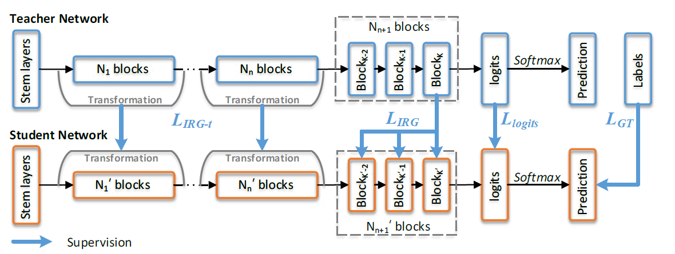
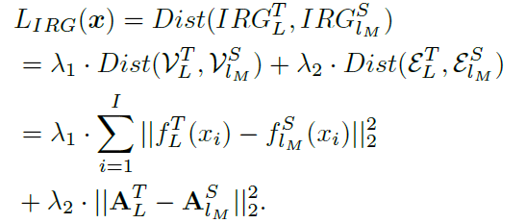
Relation-based Knowledge
考虑四种loss，第一种为teacher和student之间IRG的差异：

Slide 39

Relation-based Knowledge
第二种为teacher和student之间IRG变换的差异：

Slide 40
Relation-based Knowledge
第三种和第四种分别为response-based KD loss和ground-truth的交叉熵：

Slide 41

Relation-based Knowledge
最终Loss为：

Slide 42

Relation-based Knowledge
Notes:
随着数据集难度增大，student和teacher的gap增加。

Slide 43
03
KD Scheme: How to distill?

Slide 44
KD Scheme: How to distill?
Teacher Assistant
Mutual Learning
Self-distillation

Slide 45
KD Scheme: How to distill?
Teacher Assistant
Mutual Learning
Self-distillation

Slide 46


Teacher Assistant

Slide 47

Teacher Assistant

Slide 48

Teacher Assistant

Slide 49

Teacher Assistant

Slide 50

Teacher Assistant

Slide 51

KD Scheme: How to distill?
Teacher Assistant
Mutual Learning
Self-distillation

Slide 52


Mutual Learning

Slide 53




Mutual Learning
对于双模型系统，Loss为：
对于多模型系统，Loss有两种计算方式。第一种简单平均：
第二种集成所有其他模型的预测概率：
也可以扩展到半监督的场景：

Slide 54

Mutual Learning
Notes:
不论teacher和student分别是什么，Mutual distillation总能提升两个模型的性能

Slide 55
Mutual Learning
Notes:
对于小模型提升更显著

Slide 56
Mutual Learning
Notes:
两个小模型mutual distillation 的效果要好于用大模型作为teacher。
但是没有学习大teacher的hidden knowledge，只学习了soft-label

Slide 57

Mutual Learning
Notes:
DML_e：其他所有模型预测概率的集成作为知识
a)：K个模型平均的效果，以及标准差。模型集群数量更大则效果更一致

Slide 58

Mutual Learning

Slide 59
KD Scheme: How to distill?
Teacher Assistant
Mutual Learning
Self-distillation

Slide 60




Self-distillation

Slide 61

Self-distillation

Slide 62

Self-distillation
Notes:
简单ensemble有效，能超过最深层数的classifier
在难度更大的image net上，冗余层数更少

Slide 63


Self-distillation

Slide 64

04
Discussions

Slide 65
Discussions
BERT Knowledge
Training Efficiency & Adaptivity
KD Beyond Model Compression

Slide 66
Discussions
BERT Knowledge
Training Efficiency & Adaptivity
KD Beyond Model Compression

Slide 67

BERT Knowledge

Slide 68
Discussions
BERT Knowledge
Training Efficiency & Adaptivity
KD Beyond Model Compression

Slide 69

Training Efficiency

Slide 70

Training Efficiency

Slide 71
Training Efficiency
MobileBert
TinyBert
lower training time
MiniLM
Performance
better performance
Higher is better
BertPKD 6L
15M
66M
Task-specific Training Time
Lower is better

Slide 72

Adaptivity
HAT, DynaBERT: Hardware Adaptive

Slide 73

Adaptivity
HAT, DynaBERT: Hardware Adaptive

Slide 74



Adaptivity
HAT, DynaBERT: Hardware Adaptive
HAT Sub-network number: ${10}^{15}$
DynaBERT Sub-network number: 12

Slide 75
Adaptivity
MobileBert
TinyBert
DynaBert
Performance
15M
34M
Higher is better
Higher is better
Hardware Adaptivity

Slide 76

Adaptivity
FastBERT: Inference Time Adaptive

Slide 77

Adaptivity
FastBERT: Inference Time Adaptive
训练流程：
1、在大规模无标注语料上预训练BERT
2、在特定任务数据集上Fine-tune Backbone
3、固定Backbone，训练student classifier0~L-2：
Notes:
不是真正的self-distillation，需要先训练teacher（backbone）。

Slide 78

Adaptivity
FastBERT: Inference Time Adaptive

Slide 79
Discussions
BERT Knowledge
Training Efficiency & Adaptivity
KD Beyond Model Compression

Slide 80

KD Beyond Model Compression

Slide 81



KD Beyond Model Compression

Slide 82

KD Beyond Model Compression

Slide 83

KD Beyond Model Compression

Slide 84




